Slide 1
Bubble sort linear search binary search
BY
BHANU PRAKASH REDDY
03-03-2022

Slide 2
BUBBLE SORT:
Bubble sort is a sorting algorithm which is considered to be the simplest algorithm, which places the elements or numbers in a particular order and these elements are eventually put to their sorted proper location in the array.
Bubble sort works in the form of passes. These passes take two adjacent numbers at a single time and then compare those two numbers. If the numbers present are said to be N. Then the number of passes required to sort a data set are N – 1. Each pass sorts the data considering those two numbers and reiterates the sequence till all numbers are not sorted in the expected way.

Slide 3
SORTING:
Sorting takes an unordered collection and make it into a ordered collection.
1 2 3 4 5 6
55 | 45 | 96 | 48 | 74 | 88
45 | 48 | 55 | 74 | 88 | 96

Slide 4
Bubble Sorting:
45 55 96 48 74 88
pass 1
45 55 48 96 74 88
45 55 48 74 96 88
45 55 48 74 88 96
55 | 45 | 96 | 48 | 74 | 88
45 | 55 | 96 | 48 | 74 | 88

Slide 5
Bubble Sorting:
45 48 55 74 88 96
Numbers are in sequence after performing bubble sort.
45 | 55 | 48 | 74 | 88 | 96
45 | 55 | 48 | 74 | 88 | 96

Slide 6
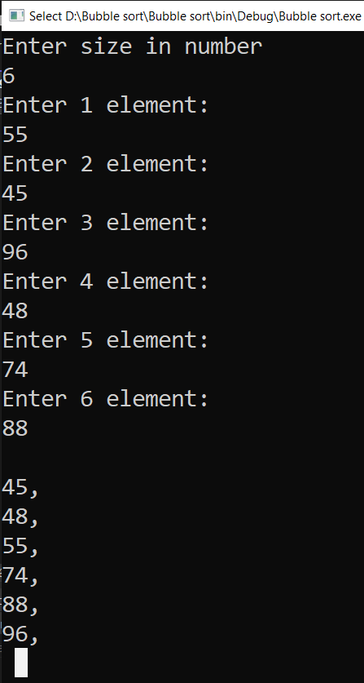
Program: Output:
int temp;
var list = new List<int>();
Console.WriteLine("Enter size in number");
int size = Convert.ToInt32(Console.ReadLine());
for(int h = 0;h<size;h++)
{
Console.WriteLine($"Enter {h+1} element:");
int ad = Convert.ToInt32(Console.ReadLine());
list.Add(ad);
}
int i = list.Count() - 1;
while(i>=0)
{
for (int j = 0; j < i; j++)
{
if (list[j] > list[j + 1])
{
temp = list[j];
list[j] = list[j + 1];
list[j + 1] = temp;
}
}
i--;
}
Console.WriteLine("");
foreach (int h in list)
Console.WriteLine(h+",");
Console.ReadLine();

Slide 7

Linear search
Linear Search is sequential search which scans one item at a time. The time taken to search a given element will increase if the number of elements in the array increases.
Find Number x = 22 in given array.
0 1 2 3 4 5 6 7
It start with the leftmost element of arr[] and start comparing x with one by one number of the arr[].
If x matches with an element, return the index number.
If x does not match with an element, return with element not found.
45 | 55 | 36 | 44 | 22 | 47 | 69 | 72

Slide 8
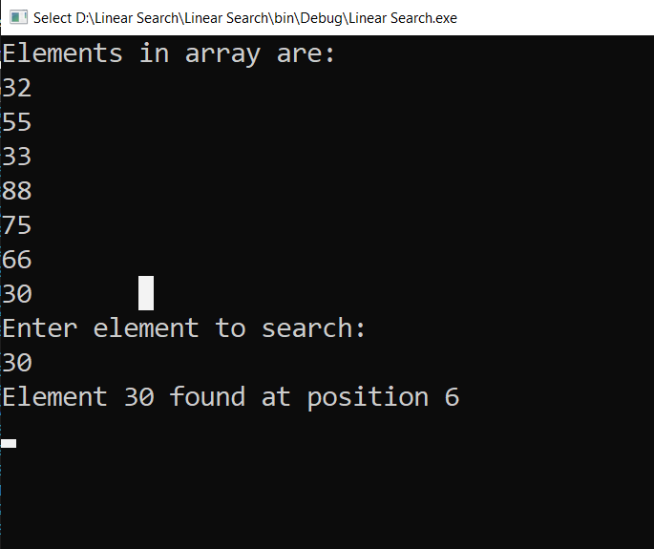
Program: Output:
int[] num = { 32, 55, 33, 88, 75, 66, 30 };
int input;
bool b = true;
Console.Write("Elements in array are: ");
foreach (int n in num)
Console.Write($"{n} ");
Console.Write("Enter element to search: ");
input = Convert.ToInt32(Console.ReadLine());
for (int i = 0; i < num.Length; i++)
{
if (num[i] == input)
{
Console.WriteLine($"Element {input} found at position {i}");
}
else
b=false;
}
if (!b)
{
Console.WriteLine("Element not found");
}
Console.ReadLine();

Slide 9
Binary Search
Search a sorted array by repeatedly dividing the search interval in half. Begin with an interval covering the whole array. If the value of the search key is less than the item in the middle of the interval, narrow the interval to the lower half. Otherwise, narrow it to the upper half. Repeatedly check until the value is found or the interval is empty.

Slide 10
Example:
Find 56
L=0 M=4 H=8
Sorted order 14 16 23 24 32 45 56 74 99
L=5 M=6 H=8
14 16 23 24 32 45 56 74 99
The output will be ‘ your element is in integer 6’ .
56 | 24 | 45 | 16 | 23 | 74 | 99 | 14 | 32

Slide 11
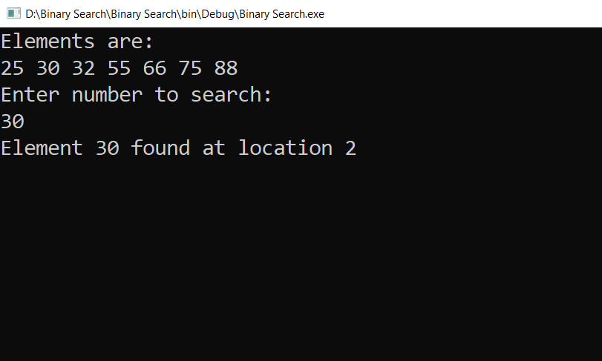
Program: Output:
int[] num = { 25, 30, 32, 55, 66, 75, 88 };
int input;
Console.WriteLine("Elements are: ");
foreach (int n in num)
Console.Write($"{n} ");
Console.WriteLine("\nEnter number to search: ");
input = Convert.ToInt32(Console.ReadLine());
int low = 0;
int high = num.Length - 1;
while (low <= high)
{
int mid = (low + high) / 2;
if (input < num[mid])
high = mid - 1;
else if (input > num[mid])
low = mid + 1;
else if (input == num[mid])
{
Console.WriteLine($"Element {input} found at location {mid + 1}");
Console.ReadLine();
return;
}
}
Console.WriteLine("Element not found");
Console.ReadLine();

Slide 12


